Slide 1
Assignment deadlines reminder
March 31st – web service programming tutorial (10%)
15% - Hot topic study journal – 3 tasks
Task 1 – March 26th
Task 2 – April 2nd
Task 3 – April 9th
10% - Exercises - Case study – April 16th

Slide 2
Hot topic study – 15% → Task 2 (5%)
Find information online about the benefits of applying service orientation in the chosen domain/industry
List the most common benefits in a table
benefits | Short description of the benefit | Link to the website where the benefit is described/mentioned

Slide 3
COMP3017 Service Computing

Slide 4

Module Seven: Hot topics in Service Computing - Cloud -

Slide 5
Topic 2: Cloud Service Models

Slide 6
Cloud service models
IaaS – Infrastructure
PaaS – Platform
SaaS – Software
as a Service

Slide 7
'… as a service’ (1)
refers to the way IT assets are consumed
It also describes the essential difference between cloud computing and traditional IT

Slide 8
'… as a service’ (2)
In traditional IT, an organization consumes IT assets - hardware, system software, development tools, applications - by purchasing them, installing them, managing them and maintaining them in its own on-premises data center.

Slide 9
'… as a service’ (3)
In cloud computing, the cloud service provider owns, manages and maintains the assets; the customer consumes them via an Internet connection, and pays for them on a subscription or pay-as-you-go basis.
There are three main types of as-a-Service solutions:
IaaS
PaaS
SaaS

Slide 10
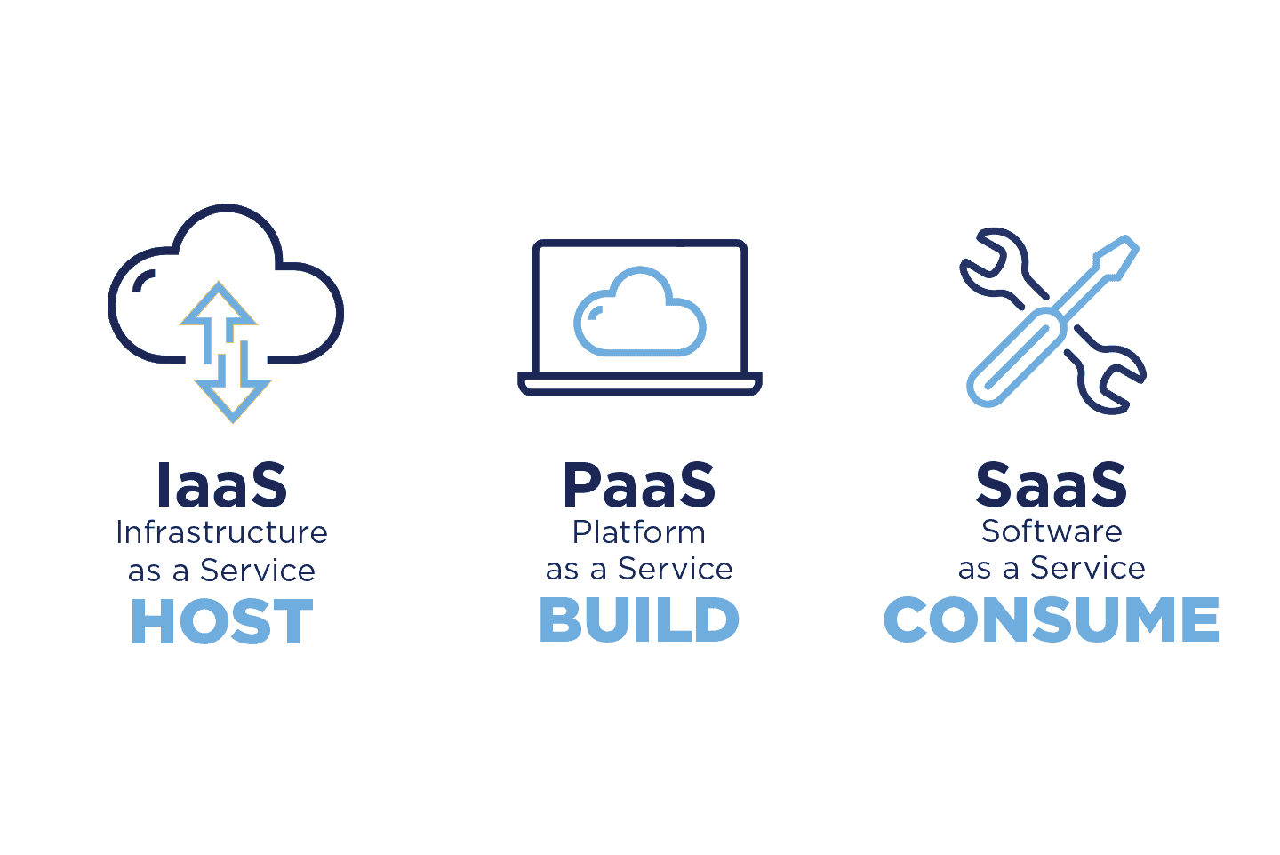

Slide 11
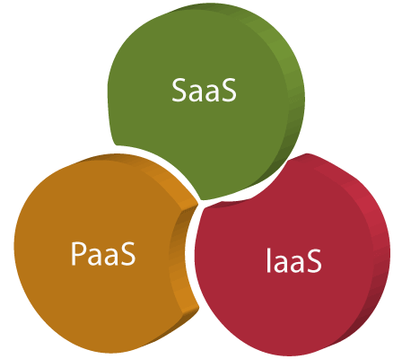
… as a service

Slide 12
… as a service
Traditional computing
Cloud computing
Computing resources are products
Own and managed internally by organizations and individuals
Computing resources become services

Slide 13
… as a service
Refers to the way IT assets are consumed in cloud computing
the cloud service provider owns, manages and maintains the assets
the customer consumes them via an Internet connection, and pays for them on a subscription or pay-as-you-go basis
There are three main types of as-a-Service solutions
IaaS
PaaS
SaaS
But there are other as-a-Service solutions available as well
XaaS

Slide 14
XaaS
There are other cloud service models described as XaaS
X represents Anything/Everything
Anything as a Service
Everything as a Service
X will be replaced with a letter describing the resource available as a service

Slide 15
Other cloud service models
Network as a service (NaaS)
Backup as a service (BaaS)
Database as a service (DBaaS)
Communications as a service (CaaS)
Storage as a service (STaaS)
Desktop as as service (DaaS)
Business Process as a Service (BPaaS)
Function as a Service (FaaS)
Artificial Intelligence as a Service (AIaaS)
…

Slide 16
Other cloud service models
Network as a service (NaaS)
Backup as a service (BaaS)
Database as a service (DBaaS)
Communications as a service (CaaS)
Storage as a service (STaaS)
Desktop as as service (DaaS)
Business Process as a Service (BPaaS)
Function as a Service (FaaS)
Artificial Intelligence as a Service (AIaaS)
…

Slide 17
AIaaS
A model of delivering artificial intelligence (AI) capabilities and services through the cloud as a subscription-based service
Allows businesses and developers to access powerful AI tools and services without having to invest inexpensive hardware and software infrastructure

Slide 18
AIaaS
Users can access a range of pre-built AI models and tools, such as natural language processing, computer vision, and predictive analytics, as well as customizable machine learning and deep learning algorithms
These services can be used to develop applications, automate business processes, and gain insight from large amounts of data

Slide 19
AIaaS Example – OpenAI API
ChatGPT and Whisper models are available on OpenAI API, giving developers access to language and speech-to-text capabilities and integrate them in their own applications
Developers can use Whisper large-v2 model in the API
ChatGPT API users have the option to choose dedicated capacity for deeper control over the models
https://openai.com/blog/openai-api
https://openai.com/blog/introducing-chatgpt-and-whisper-apis

Slide 20
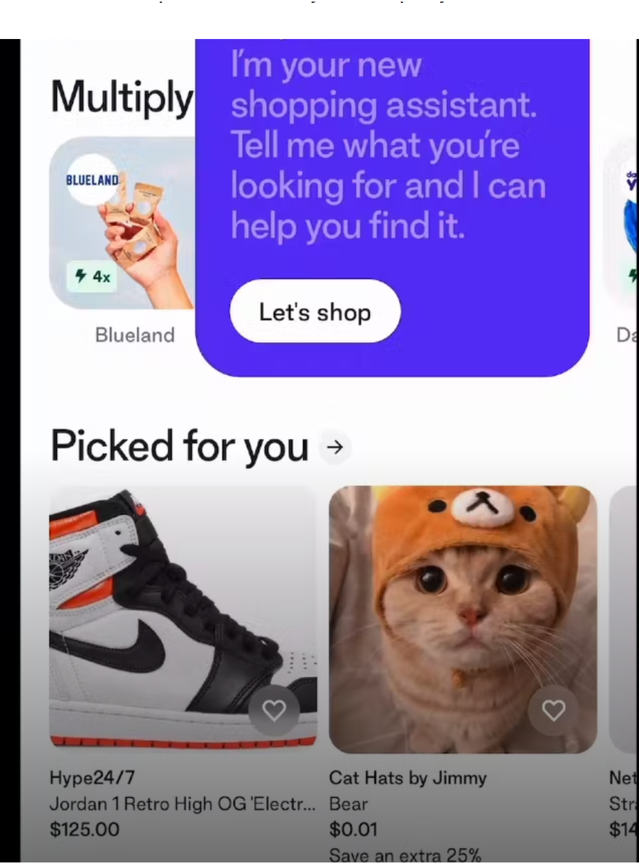
ChatGPT API use case example
Shop, Shopify’s consumer app, is used by 100 million shoppers to find and engage with the products and brands they love

Slide 21
ChatGPT API use case example
ChatGPT API is used to power Shop’s new shopping assistant
When shoppers search for products, the shopping assistant makes personalized recommendations based on their requests

Slide 22
ChatGPT API use case example
Shop’s new AI-powered shopping assistant will streamline in-app shopping by scanning millions of products to quickly find what buyers are looking for—or help them discover something new

Slide 23
More use case examples
https://openai.com/blog/introducing-chatgpt-and-whisper-apis

Slide 24
Comparison between the cloud service models
Which model should the business choose?

Slide 25
SaaS vs PaaS vs IaaS (1)
SaaS, Paas, IaaS are not mutually exclusive; most organizations use more than one, and many larger organizations today use all three, often in combination with traditional IT

Slide 26
SaaS vs PaaS vs IaaS (2)
The as-a-service solution a customer chooses depends first on the functionality the customer requires, and the expertise it has on staff
For example, an organization without the in-house IT expertise for configuring and operating remote servers isn't well matched to IaaS
An organization without a development team has no need for PaaS

Slide 27
SaaS vs PaaS vs IaaS (3)
In some cases, any of the three 'as-a-service' models will offer a viable solution
In these cases, organizations typically compare the alternatives based on the management ease they offer, vs. the control they give up

Slide 28
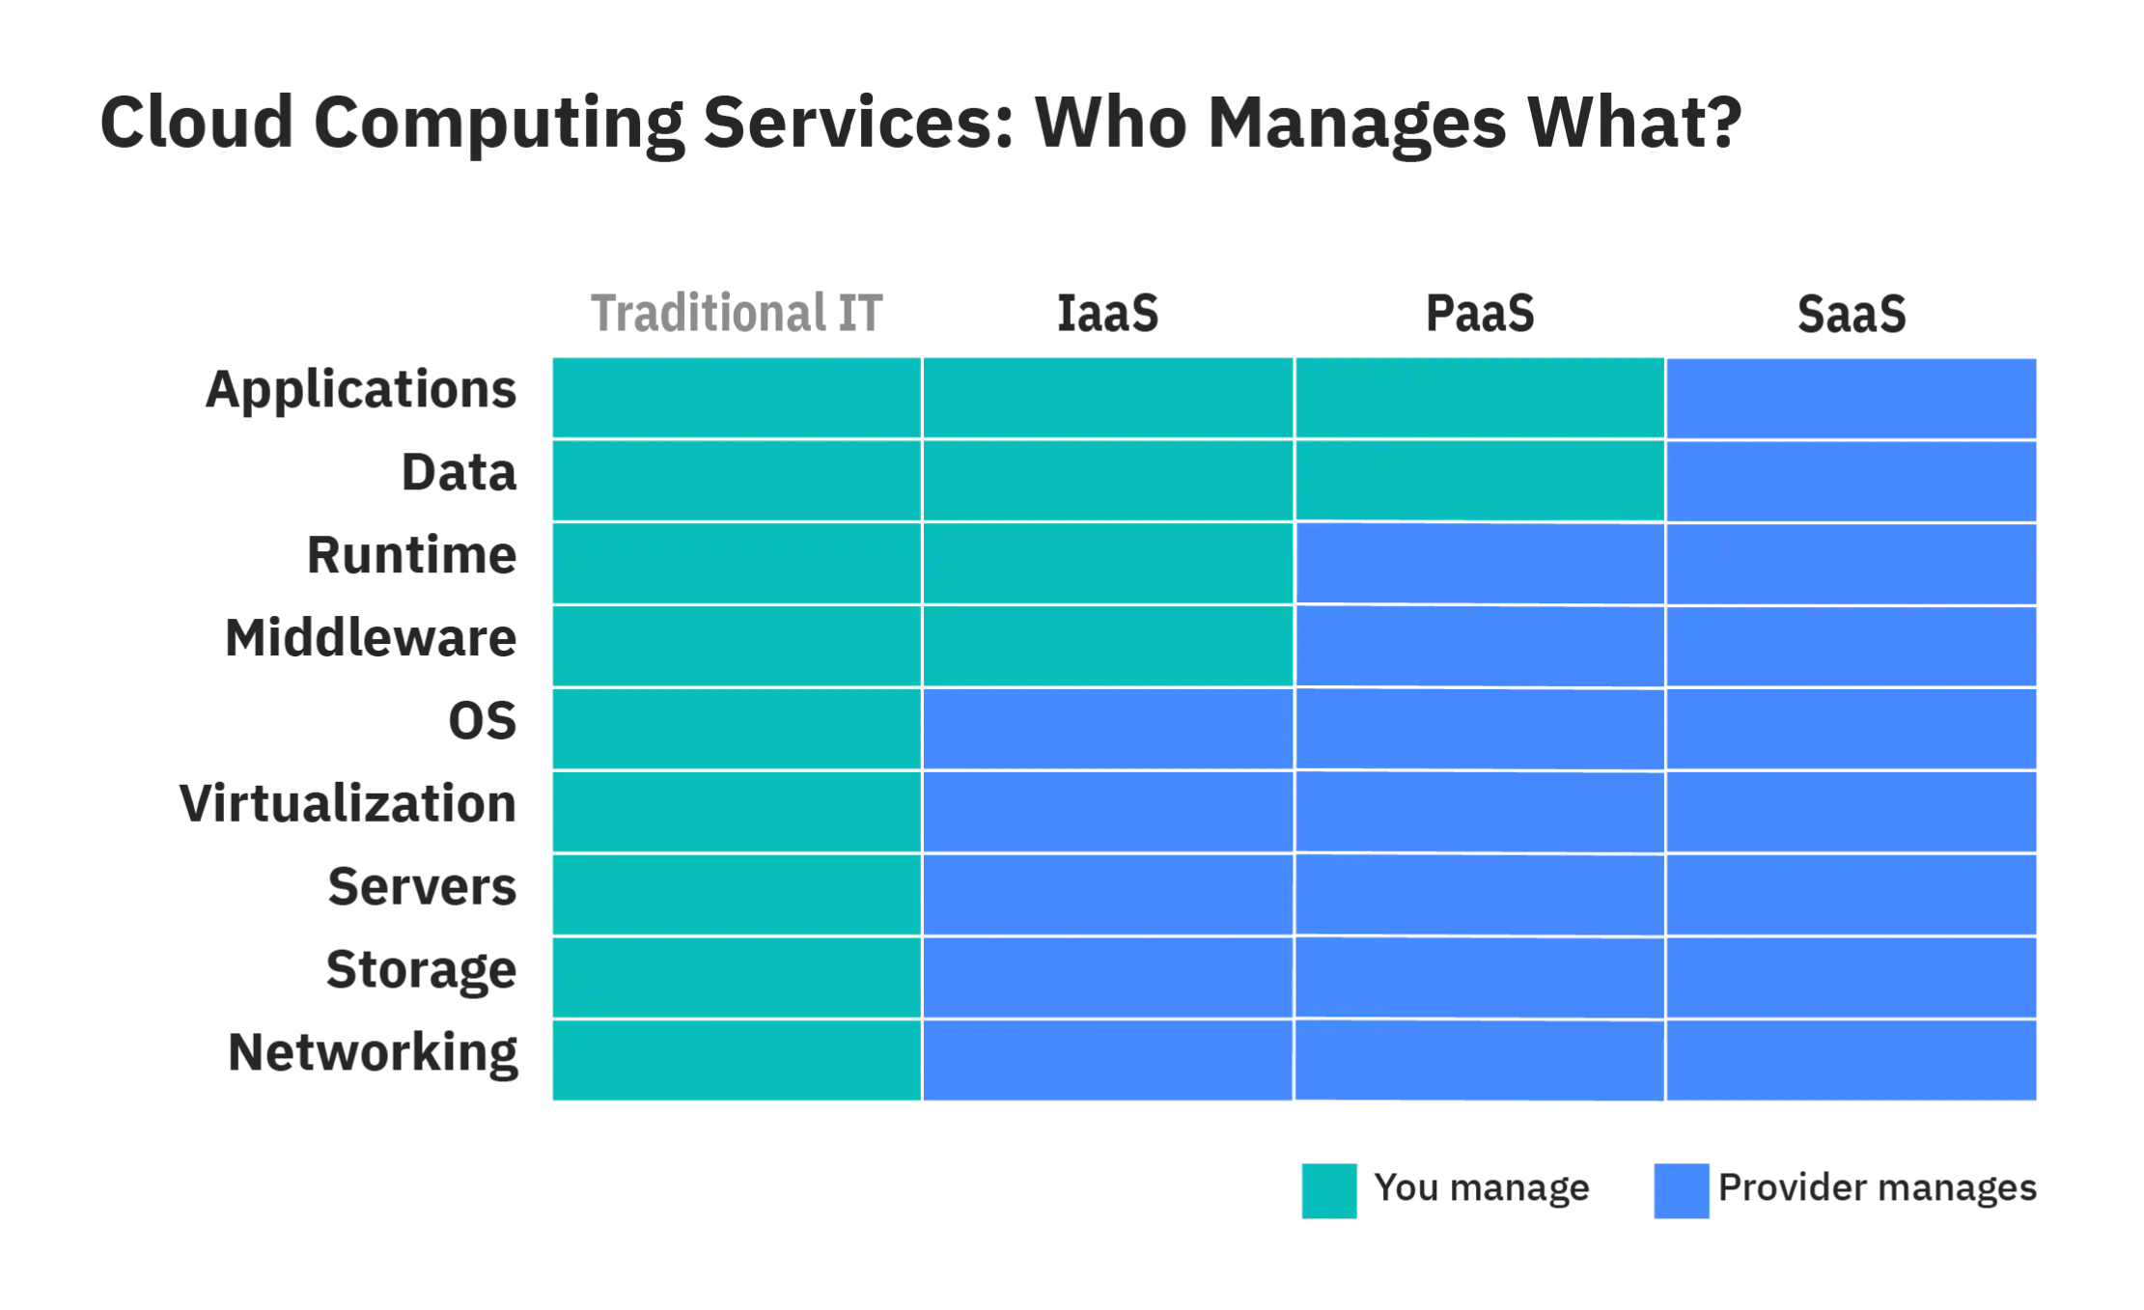
Management ease vs complete control

Slide 29
Review

Slide 30

Multiple Choice(single)
Points: 1
Which one of the following provides the resources or services such as virtual infrastructure, virtual machines, virtual storage, and several other hardware assets?
No answer，press the setting on the right side
A
IaaS
B
PaaS
C
SaaS
Submit

Slide 31
Multiple Choice(single)
Points: 1
Which one of the following provides the resources or services such as virtual infrastructure, virtual machines, virtual storage, and several other hardware assets?
A
IaaS
B
PaaS
C
SaaS
Submit

Slide 32
Discussion
In the IaaS (Infrastructure as a service) service provider maintains all the infrastructure, while the client is responsible for several other deployment aspects.

Slide 33
Azure is a public cloud computing platform—with solutions including Infrastructure as a Service (IaaS), Platform as a Service (PaaS), and Software as a Service (SaaS) that can be used for services such as analytics, virtual computing, storage, networking, and much more.
It has more than 200 products and cloud services
For the project you are currently working on, you plan to provide Infrastructure as a Service (IaaS) resources in Azure. Which resource is an example of IaaS?

Slide 34
Multiple Choice(single)
Points: 1
Remark
No answer，press the setting on the right side
Azure is a public cloud computing platform—with solutions including Infrastructure as a Service (IaaS), Platform as a Service (PaaS), and Software as a Service (SaaS) that can be used for services such as analytics, virtual computing, storage, networking, and much more.
It has more than 200 products and cloud services
For the project you are currently working on, you plan to provide Infrastructure as a Service (IaaS) resources in Azure. Which resource is an example of IaaS?
We can control hardware using IaaS resources
A
an Azure web app
B
an Azure virtual machine
C
an Azure logic app
D
an Azure SQL database
Submit
Text\Image\Formula are allowed and all the content should be placed in this area

Slide 35
Multiple Choice(single)
Points: 1
Remark
Azure is a public cloud computing platform—with solutions including Infrastructure as a Service (IaaS), Platform as a Service (PaaS), and Software as a Service (SaaS) that can be used for services such as analytics, virtual computing, storage, networking, and much more.
It has more than 200 products and cloud services
For the project you are currently working on, you plan to provide Infrastructure as a Service (IaaS) resources in Azure. Which resource is an example of IaaS?
We can control hardware using IaaS resources
A
an Azure web app
B
an Azure virtual machine
C
an Azure logic app
D
an Azure SQL database
Submit
Text\Image\Formula are allowed and all the content should be placed in this area

Slide 36
Multiple Choice(single)
Points: 1
Which one of the following can be considered as the most complete cloud computing service model?
No answer，press the setting on the right side
A
IaaS – Infrastructure as a Service
B
PaaS - Platform as a Service
C
SaaS – Software as a Service
Submit

Slide 37
Multiple Choice(single)
Points: 1
Which one of the following can be considered as the most complete cloud computing service model?
A
IaaS – Infrastructure as a Service
B
PaaS - Platform as a Service
C
SaaS – Software as a Service
Submit

Slide 38
Discussion
The most complete cloud computing service model must contain the computing hardware and software, as well as the solution itself.
Hence the SaaS model has all these features.

Slide 39
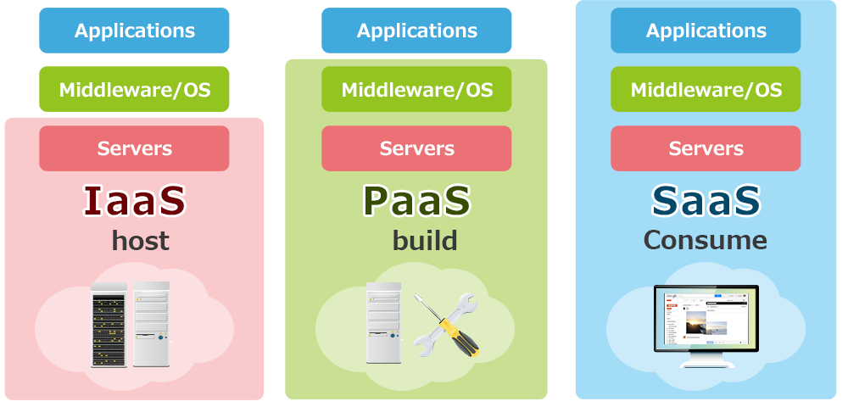
Discussion

Slide 40
Summary
The IaaS model offers the computing resources companies need to host, build and run their services
The PaaS model provides an environment for developers to build and deploy applications
The SaaS model delivers software to users and companies over the Internet
Each cloud service model offers different features and benefits to businesses. Therefore, as we mentioned at the beginning of the article, these three cloud service models are often used simultaneously within companies

Slide 41
Topic 3: Cloud Stakeholders, Cloud Standardization, Cloud Computing Reference Architecture

Slide 42
Intended learning outcomes
After completing this topic, you will be able to:
List different cloud stakeholders
Understand the roles of the cloud stakeholders
Be aware of the concerns of the cloud stakeholders

Slide 43
What is a stakeholder

Slide 44
What is a stakeholder
Anyone who has interest in the value cloud computing technology creates
Anyone who is affected positively by it
Anyone who is affected negatively by it

Slide 45
Who are cloud stakeholders?

Slide 46
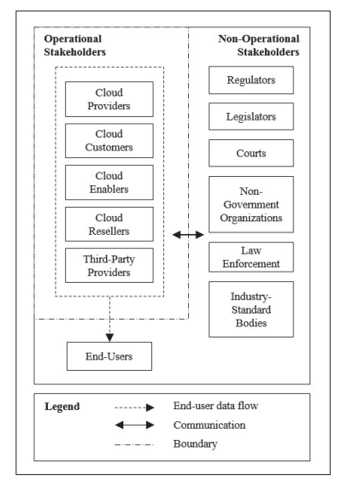
Cloud Stakeholders

Slide 47
Cloud Stakeholders

Slide 48
Operational stakeholders
Stakeholders who perform and conduct cloud operations

Slide 49
Operational stakeholders
Cloud providers
Cloud customers
End-users
Cloud enablers
Cloud resellers
Third-party providers

Slide 50

Operational stakeholders
Cloud providers
Cloud customers
End-users
Cloud enablers
Cloud resellers
Third-party providers

Slide 51
Cloud provider
A cloud service provider is an information technology (IT) company that provides its customers with computing resources over the internet and delivers them on-demand
Popular examples of cloud service providers include:
Amazon Web Services (AWS)
Microsoft Azure
Google Cloud
Alibaba Cloud
IBM Cloud
Salesforce

Slide 52
Cloud provider concerns
Resource utilization
Energy efficiency
Metering
Providing resources
Meet end user requirements
…

Slide 53
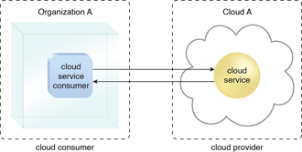
Cloud customer/consumer
A cloud customer (cloud consumer) represents a person or organization that maintains a business relationship with, and uses the service from a cloud provider

Slide 54
Cloud customer/consumer
A cloud customer browses the service catalog from a cloud provider, requests the appropriate service, sets up service contracts with the cloud provider, and uses the service
The cloud consumer may be billed for the service provisioned, and needs to arrange payments accordingly

Slide 55
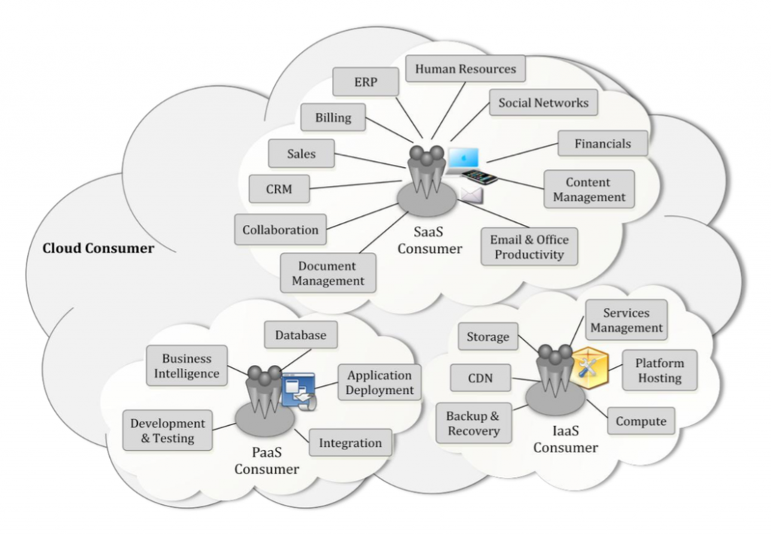
Cloud services available to a cloud consumer

Slide 56
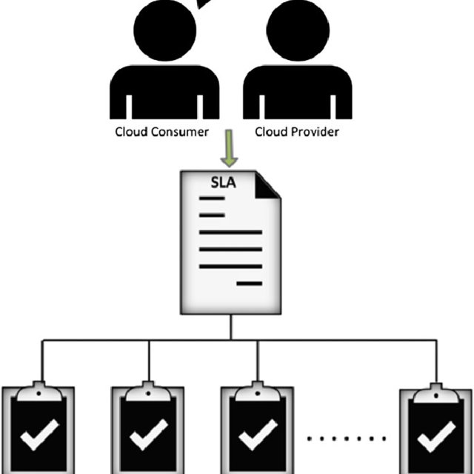
SLA
A cloud customer has a formal contract or arrangement with a cloud provider to use IT resources made available by the cloud provider
A service-level agreement is a commitment between a service provider and a client

Slide 57
SLA
Cloud consumers need SLAs to specify the technical performance requirements fulfilled by a cloud provider
quality of service
security
remedies for performance failures
A cloud provider may also list in the SLAs limitations and obligations that cloud consumers must accept
Typically, a cloud provider’s pricing policy and SLAs are non-negotiable, unless the customer expects heavy usage and might be able to negotiate for better contracts.

Slide 58
Operational stakeholders
Cloud providers
Cloud customers
End-users
Cloud enablers
Cloud resellers
Third-party providers

Slide 59
Operational stakeholders
Cloud providers
Cloud customers
End-users
Cloud enablers
Cloud resellers
Third-party providers

Slide 60
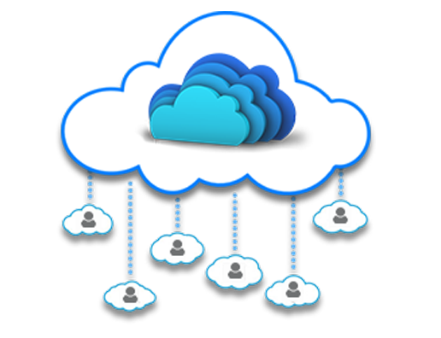
End-user
People who simply use cloud services on an everyday basis
employees inside a company who are end users of the company’s cloud services
general public, connecting to cloud services designed for massive public consumption
Most end users have no special technical skills

Slide 61
End user concerns
Security
Privacy
High availability
Ease of use
…

Slide 62
Operational stakeholders
Cloud providers
Cloud customers
End-users
Cloud enablers
Cloud resellers
Third-party providers

Slide 63
Example - Rain Classroom - 雨课堂
Rain Classroom is a cloud computing tool, which is jointly developed by Tsinghua University and XueTangX.
HITSZ purchased a school membership that allows HITSZ staff and students to access Rain Classroom functions
In this scenario
Who is cloud provider?
Who is cloud customer?
Who is cloud end-user?

Slide 64
Example - Rain Classroom - 雨课堂
Rain Classroom is a cloud computing tool, which is jointly developed by Tsinghua University and XueTangX.
HITSZ purchased a school membership that allows HITSZ staff and students to access Rain Classroom functions
In this scenario
Who is cloud provider?
Who is cloud customer?
Who is cloud end-user?

Slide 65
Example - Rain Classroom - 雨课堂
Rain Classroom is a cloud computing tool, which is jointly developed by Tsinghua University and XueTangX.
HITSZ purchased a school membership that allows HITSZ staff and students to access Rain Classroom functions
In this scenario
Who is cloud provider?
Who is cloud customer?
Who is cloud end-user?

Slide 66
Example - Rain Classroom - 雨课堂
Rain Classroom is a cloud computing tool, which is jointly developed by Tsinghua University and XueTangX.
HITSZ purchased a school membership that allows HITSZ staff and students to access Rain Classroom functions
In this scenario
Who is cloud provider?
Who is cloud customer?
Who is cloud end-user?

Slide 67
Operational stakeholders
Cloud providers
Cloud customers
End-users
Cloud enablers
Cloud resellers
Third-party providers

Slide 68
Cloud enabler
Cloud enablers are information technology (IT) firms that create hardware, software, storage devices, networking equipment, and other related cloud environment components

Slide 69
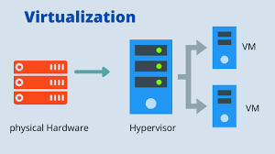
Cloud enabler example
An organization that manufactures virtualization hypervisors that enable virtual machines (VMs) is a cloud enabler
A hypervisor is hardware, software, or firmware capable of creating virtual machines and then managing and allocating resources to them

Slide 70
Cloud enabler vs cloud provider
A cloud enabler is different from a cloud service provider
Cloud service providers use the technologies built by cloud enablers to deliver cloud-based services to end-users

Slide 71
Why are cloud enablers important?
Cloud enablers serve as the backbone for cloud products and services offered by a cloud provider
Developing a scalable, reliable, and robust cloud computing service is complex and requires many technical skills and hard work
Let a company build, deploy, integrate, and deliver cloud computing solutions

Slide 72
Why are cloud enablers important?
Cloud enablers make it possible for the cloud customers to move their resources to the cloud
Cloud enablers play a critical role in coming up with cloud strategies, service selection, and cloud app development and infrastructure establishment
A cloud enabler is a huge part of building, deploying, integrating, and delivering cloud computing solutions

Slide 73
Cloud reseller
A cloud reseller is a service provider who buys cloud computing products and services from major providers like AWS or Google, which they then resell to their own customers

Slide 74
Cloud reseller
A cloud computing reseller acts as a valued added reseller (VAR) when they combine and/or complement the cloud product/service with additional value or functionality.

Slide 75
Cloud reseller - example
A cloud computing reseller combines their photo editing software with cloud provider’s storage service to enhance the value of software product

Slide 76
Third-party providers
A company that provides cloud services to another company without a contract
When contracting for cloud-computing services, one challenge is that there may be more parties involved than the cloud customer and the cloud provider

Slide 77



Third-party providers - example
A cloud user uses services of a SaaS provider Dropbox

Slide 78
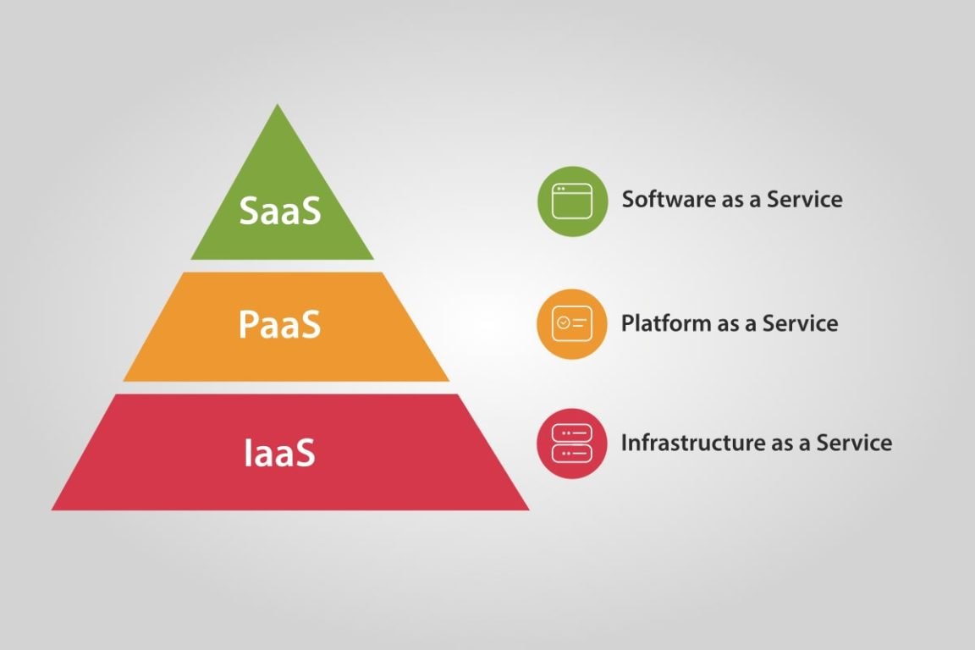


Third-party providers - example
Dropbox is running its service in the data center of a third-party IaaS vendor, Amazon Web Services

Slide 79
Third-party providers - example
In this scenario
Dropbox is a service provider
AWS is a third-party provider

Slide 80

Third-party providers - example
This can increase the complexity of a cloud-computing contract, especially in determining which provider is responsible for which action

Slide 81
Third-party provider challenges
The introduction of third parties can increase risk
It's essential for potential cloud customers to identify third parties before adopting a cloud service, thoroughly understand their roles and ensure that their responsibilities are effectively addressed in the contract

Slide 82
Cloud Stakeholders

Slide 83
Cloud Stakeholders

Slide 84
Developing laws for cloud computing
Protecting the customers' and service provider's rights has become quite challenging for Cloud Computing
Different countries have their own specific jurisdiction, laws, and regulations.
There are diverse stakeholders that ensure the development of efficient and fair laws for both the customers and service providers

Slide 85
Legal issues in cloud computing
Legal issues that can arise “in the cloud” include
liability for copyright infringement
data breaches
security violations, privacy violations
data loss, data management
hacking, cybersecurity
…
There are diverse stakeholders that ensure that legal standards, regulations, and norms relating to cloud computing are being developed

Slide 86
Highly regulated industries
Highly regulated industries face specific industry regulatory requirements, standards and laws
Healthcare
Finance
Government
…
There are diverse stakeholders that ensure that organizations operating within these industries are compliant with the requirements

Slide 87
Cloud Stakeholders

Slide 88
Non-Operational Stakeholders
Cloud computing standards and laws in China
International cloud computing standards

Slide 89
Cloud computing standards and laws in China

Slide 90

Chinese cloud providers
Most popular Chinese cloud providers
Alibaba Cloud
Tencent Cloud
China Telecom Cloud
Huawei Cloud
Baidu Cloud

Slide 91
International cloud providers in China
International cloud providers have to operate in the Chinese market by cooperating with domestic service providers
Examples
AWS is run by Sinnet in Beijing and by Ningxia Western Cloud Data Technology (NWCD) in Ningxia
Microsoft Azure is branded as Azure China and operated locally by 21Vianet

Slide 92
Security related regulation
China Cybersecurity Law (CSL) - 2017
all network operators must comply with the CSL
Classified Protection of Cybersecurity Scheme(Multi-Level Protection Scheme (MLPS) - 2008/2019
MLPS was first introduced in 2008 and updated to MLPS 2.0 in 2019
a regulatory scheme designed to protect the cybersecurity of networks and systems in China
it is compulsory for all companies and individuals that own, operate, or provide services relating to network and corresponding system components in China to follow the national standards under the MLPS scheme
China Data Security Law (DSL) - 2021
stipulates the security of data related activities in mainland China such as collection, storage, processing, usage, provision, trading and publishing, etc.

Slide 93
Privacy related regulation
China Personal Information Protection Law (PIPL) – 2021
It is the first law framework over personal data protection in mainland China to protect personal information rights and interests, regulate the processing of personal information, and promote the reasonable use of personal information
regulates the data related activities pertaining to personal data
Other than PIPL, the data protection requirements can also be found in various other regulations

Slide 94
Financial industry standards on cloud computing technology
The National Financial Standardization Technical Committee ('NFSTC') announced, on 27 October 2020, that the People's Bank of China has released three financial industry standards on cloud computing
Technical Framework of Cloud Computing Technology Financial Application Specification (JR/T 0166-2020) ('the Cloud Computing Framework Specification')
Cloud Computing Technology Financial Application Specification Security Technical Requirements (JR/T 0167-2020) ('the Cloud Computing Security Specification')
focuses on the potential risks of cloud computing financial applications
outlines requirements for data security and security management
proposes policies
Cloud Computing Technology Financial Application Specification Disaster Recovery (JR/T 0168-2020) ('Cloud Computing Disaster Recovery Specification')
stipulates technical requirements that all cloud computing participants should follow when measuring the cloud computing platform's disaster tolerance capability and carrying out the disaster recovery work of the cloud computing platform

Slide 95
International cloud computing standards

Slide 96



International standard organizations
ISO
International Organization for Standardization
ITU
International Telecommunication Union
IEC
International Electrotechnical Commission

Slide 97
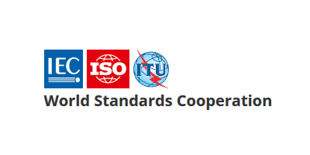
World Standards Cooperation alliance
Together, these three organizations have formed the World Standards Cooperation alliance

Slide 98
ISO - The International Organization for Standardization
An international standard development organization
It works in 167 countries
Develops and publishes standardization in all technical and nontechnical fields other than electrical and electronic engineering
Electronic engineering standards are responsibility of IEC - International Electrotechnical Commission

Slide 99
ISO Standardization process
ISO has 804 technical committees and subcommittees concerned with standards development
International Standards are developed by ISO technical committees (TC) and subcommittees (SC) by a process with six steps
Stage 1: Proposal stage
Stage 2: Preparatory stage
Stage 3: Committee stage
Stage 4: Enquiry stage
Stage 5: Approval stage
Stage 6: Publication stage
As of April 2022, the ISO has developed over 24,261 standards, covering everything from manufactured products and technology to food safety, agriculture, and healthcare

Slide 100
Joint technical committee with IEC
ISO/IEC JTC 1
ISO has a joint technical committee (JTC) with the International Electrotechnical Commission (IEC) to develop standards relating to information technology

Slide 101
ISO/IEC JTC 1 Scope and mission
Develop, maintain, promote and facilitate IT standards required by global markets meeting business and user requirements concerning:
The design and development of IT systems and tools
The performance and quality of IT products and systems
The security of IT systems and information
The portability of application programs
The interoperability of IT products and systems
The unified tools and environments
The harmonized IT vocabulary
The user-friendly and ergonomically-designed user interfaces

Slide 102
ISO/IEC JTC 1 Structure
Most work on the development of standards is done by subcommittees (SCs), each of which deals with a particular field
Subcommittee dealing with the field of cloud computing is called ISO/IEC JTC 1/SC 38
Most of these subcommittees have several working groups (WGs)

Slide 103
Standardization of cloud computing

Slide 104
Standardization of cloud computing - definition
The implementation of standards in cloud computing industry

Slide 105
Where are technical standards developed?
The main technical committees active in Cloud Computing standardization
ISO/IEC JTC 1/SC 38 “Cloud Computing and Distributed Platforms”
ITU-T/SG 13 “Future networks and emerging network technologies”
ISO/IEC JTC 1/SC 27 “Information security, cybersecurity and privacy protection”
ITU-T/SG 17 “Security”

Slide 106
Where are technical standards developed?
The main technical committees active in Cloud Computing standardization
ISO/IEC JTC 1/SC 38 “Cloud Computing and Distributed Platforms”
ITU-T/SG 13 “Future networks and emerging network technologies”
ISO/IEC JTC 1/SC 27 “Information security, cybersecurity and privacy protection”
ITU-T/SG 17 “Security”

Slide 107
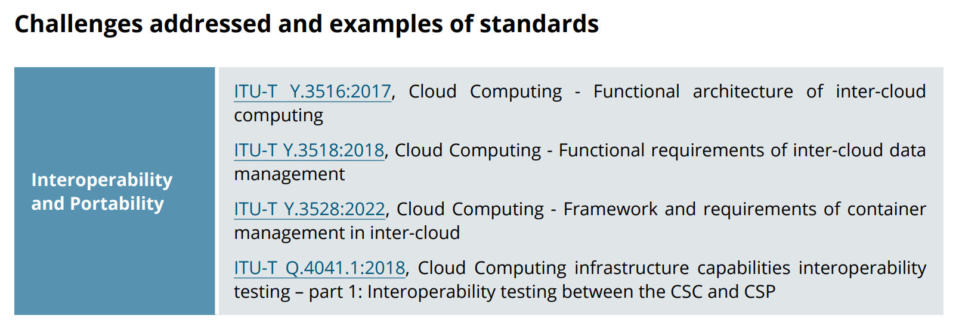
ITU-T/SG 13 “Future networks and emerging network technologies”

Slide 108
Where are technical standards developed?
The main technical committees active in Cloud Computing standardization
ISO/IEC JTC 1/SC 38 “Cloud Computing and Distributed Platforms”
ITU-T/SG 13 “Future networks and emerging network technologies”
ISO/IEC JTC 1/SC 27 “Information security, cybersecurity and privacy protection”
ITU-T/SG 17 “Security”

Slide 109
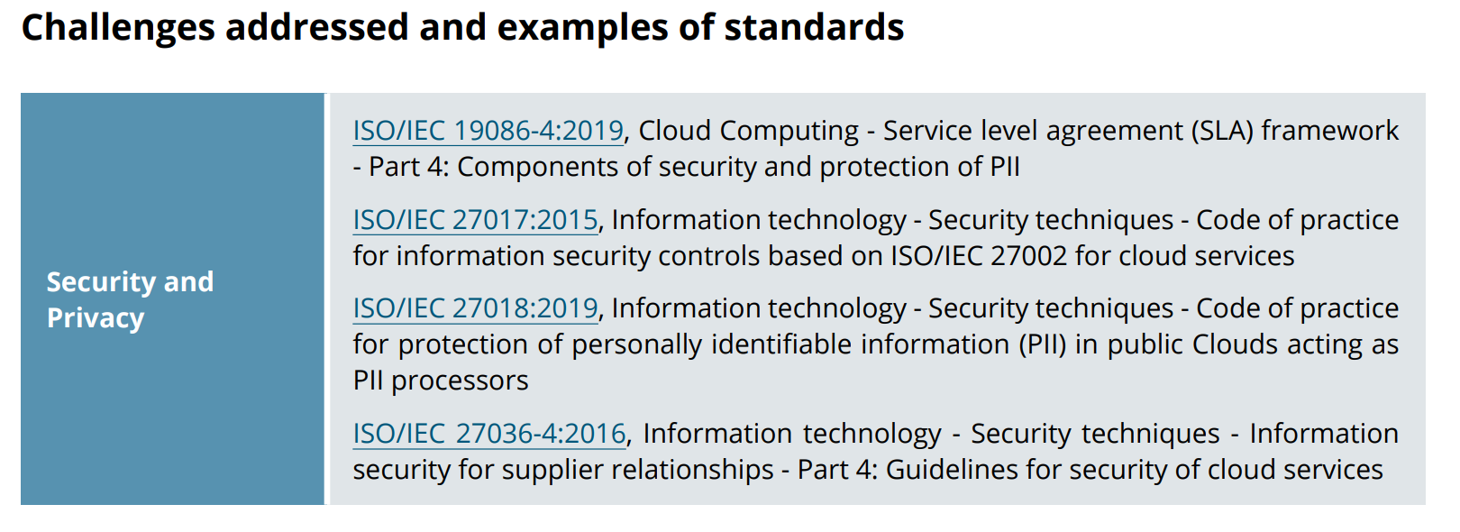
ISO/IEC JTC 1/SC 27 “Information security, cybersecurity and privacy protection”

Slide 110
Where are technical standards developed?
The main technical committees active in Cloud Computing standardization
ISO/IEC JTC 1/SC 38 “Cloud Computing and Distributed Platforms”
ITU-T/SG 13 “Future networks and emerging network technologies”
ISO/IEC JTC 1/SC 27 “Information security, cybersecurity and privacy protection”
ITU-T/SG 17 “Security”

Slide 111
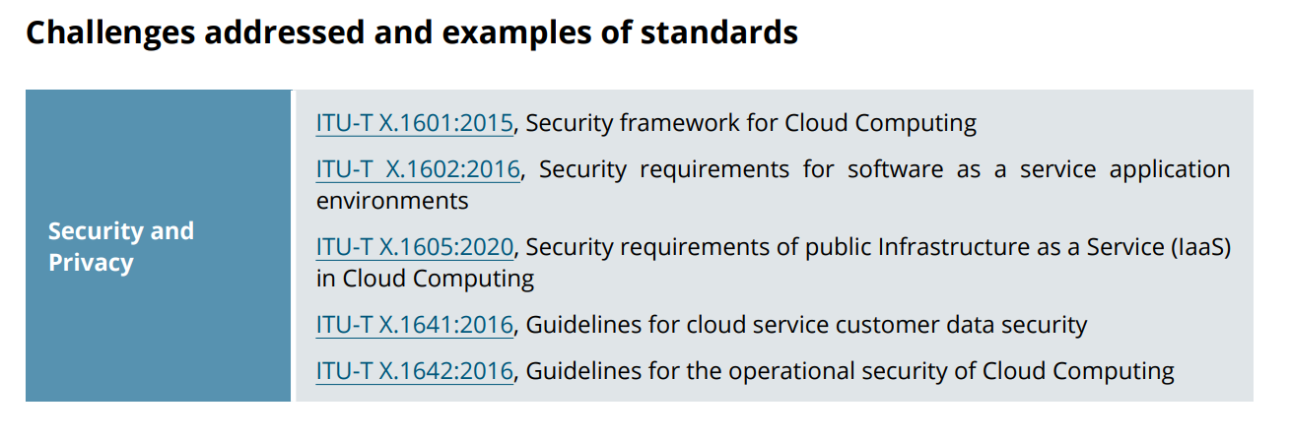
ITU-T/SG 17 “Security”

Slide 112
Where are technical standards developed?
The main technical committees active in Cloud Computing standardization
ISO/IEC JTC 1/SC 38 “Cloud Computing and Distributed Platforms”
ITU-T/SG 13 “Future networks and emerging network technologies”
ISO/IEC JTC 1/SC 27 “Information security, cybersecurity and privacy protection”
ITU-T/SG 17 “Security”

Slide 113
ISO/IEC JTC 1/SC 38 “Cloud Computing and Distributed Platforms”

Slide 114
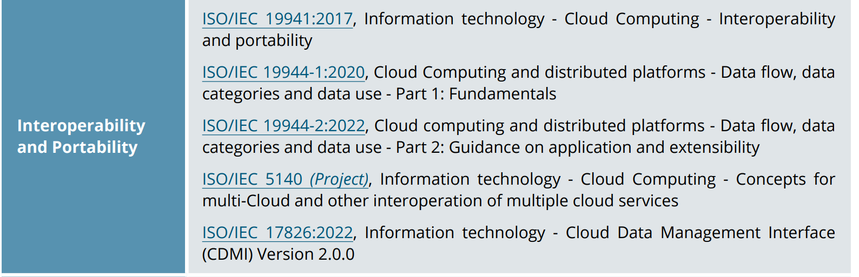
ISO/IEC JTC 1/SC 38 “Cloud Computing and Distributed Platforms”

Slide 115
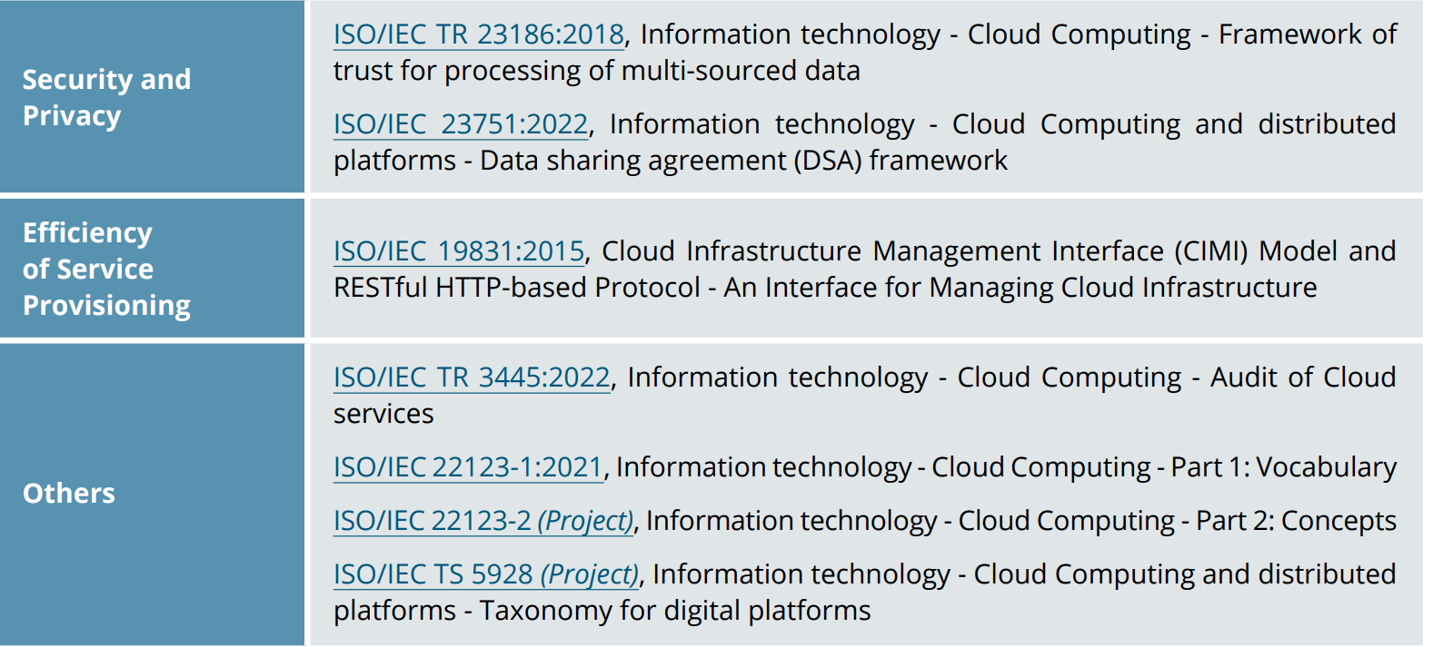
ISO/IEC JTC 1/SC 38 “Cloud Computing and Distributed Platforms”

Slide 116
ISO/IEC JTC 1/SC 38 “Cloud Computing and Distributed Platforms”
We will introduce the works of this subcommittee in more details

Slide 117
ISO/IEC JTC 1/SC 38
ISO/IEC JTC 1/SC 38 Cloud Computing and Distributed Platforms
A standardization subcommittee
Develops standards to assist organizations in specifying, acquiring and applying Cloud Computing and distributed platform technologies and services.

Slide 118
Member countries
29 participating members
Australia, Austria, Belgium, Brazil, Canada, China, Denmark, Finland, France, Germany, India, Ireland, Israel, Italy, Japan, Republic of Korea, Luxembourg, Netherlands, Poland, Portugal, Russian Federation, Singapore, Slovakia, South Africa, Spain, Sweden, Switzerland, United Kingdom, and United States of America
8 observing members

Slide 119
Scope and mission
The scope of ISO/IEC JTC 1/SC 38 is the “Standardization in the area of Cloud Computing and Distributed Platforms”.
Foundational concepts and technologies
Operational issues
Interactions among Cloud Computing systems and with other distributed systems

Slide 120
ISO/IEC JTC 1/SC 38 Structure
ISO/IEC JTC 1/SC 38 is made up of two working groups (WGs)
Each working group carries out specific tasks in standards development within the field of Cloud Computing and Distributed Platforms
Working Group | Working Area
ISO/IEC JTC 1/SC 38/WG 3 | Cloud Computing Fundamentals (CCF)
ISO/IEC JTC 1/SC 38/WG 5 | Cloud Computing Data and its Flow (CCDF)

Slide 121
WG 3 - CLOUD COMPUTING FUNDAMENTALS (CCF)
Cloud Computing Fundamentals (CCF)
Projects related to Cloud Computing Service Agreements
Projects related to fundamental concepts, terminology and definitions for Cloud Computing
Projects related to guidance on use of international standards in the development of policies that govern or regulate cloud service providers and cloud services, and policies that govern the use of cloud services in enterprise organizations
Establish liaisons and collaborate with other entities within JTC 1, SDOs and consortia performing work related to Cloud Computing

Slide 122
WG 5 – DATA IN CLOUD COMPUTING AND RELATED TECHNOLOGIES
Cloud Computing Data and its Flow (CCDF)
Standardization in the area of data in cloud computing, distributed platforms, connected devices and related technologies
Establish liaisons and collaborate with other entities within and external to JTC 1 as appropriate

Slide 123
Standards developed by ISO/IEC JTC 1/SC 38
ISO/IEC JTC 1/SC 38 published many standards in the area of
Cloud Computing
Web Services
Service Oriented Architecture (SOA)

Slide 124
Standards developed by ISO/IEC JTC 1/SC 38
ISO/IEC JTC 1/SC 38 has 15 published standards in the area of
Cloud Computing
Web Services
Service Oriented Architecture (SOA)

Slide 125
ISO/IEC 17203
Information technology — Open Virtualization Format (OVF) specification
Specifies an open, secure, portable, efficient and extensible format for the packaging and distribution of software to be run in virtual machines

Slide 126
ISO/IEC 17788
Information technology -- Cloud computing -- Overview and vocabulary
Provides an overview of cloud computing along with a set of terms and definitions

Slide 127
ISO/IEC 17789
Information technology — Cloud computing — Reference architecture
Specifies the cloud computing reference architecture (CCRA)
cloud computing roles
cloud computing activities
cloud computing functional components and their relationships

Slide 128
ISO/IEC 17826
Information technology – Cloud Data Management Interface (CDMI)
Specifies the interface to access cloud storage and to manage the stored data

Slide 129
ISO/IEC 19086-1
Information technology — Cloud computing — Service level agreement (SLA) framework — Part 1: Overview and concepts
Establishes a set of common cloud SLA building blocks (concepts, terms, definitions, contexts) that can be used to create cloud Service Level Agreements (SLAs).

Slide 130
ISO/IEC 19086-2
Cloud computing — Service level agreement (SLA) framework — Part 2: Metric model
Establishes common terminology, defines a model for specifying metrics for cloud SLAs, and includes applications of the model with examples.

Slide 131
ISO/IEC 19086-3
Information technology — Cloud computing — Service level agreement (SLA) framework — Part 3: Core conformance requirements
Specifies the core conformance requirements for service level agreements (SLAs) for cloud services based on ISO/IEC 19086‑1 and guidance on the core conformance requirements.

Slide 132
ISO/IEC 19941
Information technology — Cloud computing — Interoperability and portability
Specifies cloud computing interoperability and portability types, the relationship and interactions between these two cross-cutting aspects of cloud computing and common terminology and concepts used to discuss interoperability and portability, particularly relating to cloud services.

Slide 133
ISO/IEC 19944
Information technology — Cloud computing — Cloud services and devices: Data flow, data categories and data use
Extends the existing cloud computing vocabulary and reference architecture in ISO/IEC 17788 and ISO/IEC 17789 to describe an ecosystem involving devices using cloud services

Slide 134
ISO/IEC TR 22678
Information technology — Cloud computing — Guidance for policy development
Provides guidance on the use of international standards as a tool in the development of those policies that govern or regulate cloud service providers (CSPs) and cloud services, and those policies and practices that govern the use of cloud services in organisations.

Slide 135
ISO/IEC TR 23186
Information technology — Cloud computing — Framework of trust for processing of multi-sourced data
Describes a framework of trust for the processing of multi-sourced data that includes data use obligations and controls, data provenance, chain of custody, security and immutable proof of compliance as elements of the framework.

Slide 136
Standards developed by ISO/IEC JTC 1/SC 38
ISO/IEC JTC 1/SC 38 has 15 published standards in the area of
Cloud Computing
Web Services
Service Oriented Architecture (SOA)

Slide 137
ISO/IEC 17963
Web Services for Management (WS-Management) Specification
Describes a Web services protocol based on SOAP for use in management‑specific domains

Slide 138
Standards developed by ISO/IEC JTC 1/SC 38
ISO/IEC JTC 1/SC 38 has 15 published standards in the area of
Cloud Computing
Web Services
Service Oriented Architecture (SOA)

Slide 139
ISO/IEC 17998
Information technology – SOA Governance Framework
Describes a framework for providing context and definitions related to SOA for organizations to use when deploying SOA governance.
Defines:
SOA Governance
SOA Governance Reference Model
SOA Governance Vitality Model

Slide 140
ISO/IEC 18384-1
Information technology — Reference Architecture for Service Oriented Architecture (SOA RA) — Part 1: Terminology and concepts for SOA
Establishes vocabulary, guidelines, and general technical principles underlying service oriented architecture (SOA), including principles relating to functional design, performance, development, deployment, and management.

Slide 141
ISO/IEC 18384-1
Information technology — Reference Architecture for Service Oriented Architecture (SOA RA) — Part 1: Terminology and concepts for SOA
Establishes vocabulary, guidelines, and general technical principles underlying service oriented architecture (SOA), including principles relating to functional design, performance, development, deployment, and management.

Slide 142
ISO/IEC 18384-2
Information technology — Reference Architecture for Service Oriented Architecture (SOA RA) — Part 2: Reference Architecture for SOA Solutions
Describes a Reference Architecture for SOA Solutions which applies to functional design, performance, development, deployment and management of SOA Solutions.

Slide 143
ISO/IEC 18384-3
Information technology — Reference Architecture for Service Oriented Architecture (SOA RA) — Part 3: Service Oriented Architecture ontology
Defines a formal ontology for service-oriented architecture (SOA), an architectural style that supports service orientation. The terms defined in this ontology are key terms from the vocabulary in ISO/IEC 18384-1.

Slide 144
ISO/IEC TR 30102
Information technology – Distributed Application Platforms and Services (DAPS) – General technical principles of Service Oriented Architecture
Describes general technical principles underlying SOA including principles relating to functional design, performance, development, deployment and management

Slide 145
Importance of foundational standards
Two foundational standards that deal with vocabulary and reference architecture
ISO/IEC 17788:2014 “Information technology — Cloud computing — Overview and vocabulary”
ISO/IEC 17789:2014 “Information technology — Cloud computing — Reference architecture”.
Essential for developing other standards

Slide 146
Importance of foundational standards
Two foundational standards that deal with vocabulary and reference architecture
ISO/IEC 17788:2014 “Information technology — Cloud computing — Overview and vocabulary”
ISO/IEC 17789:2014 “Information technology — Cloud computing — Reference architecture”.
Essential for developing other standards

Slide 147
Cloud Computing Reference Architecture

Slide 148
Cloud Computing Reference Architecture

Slide 149
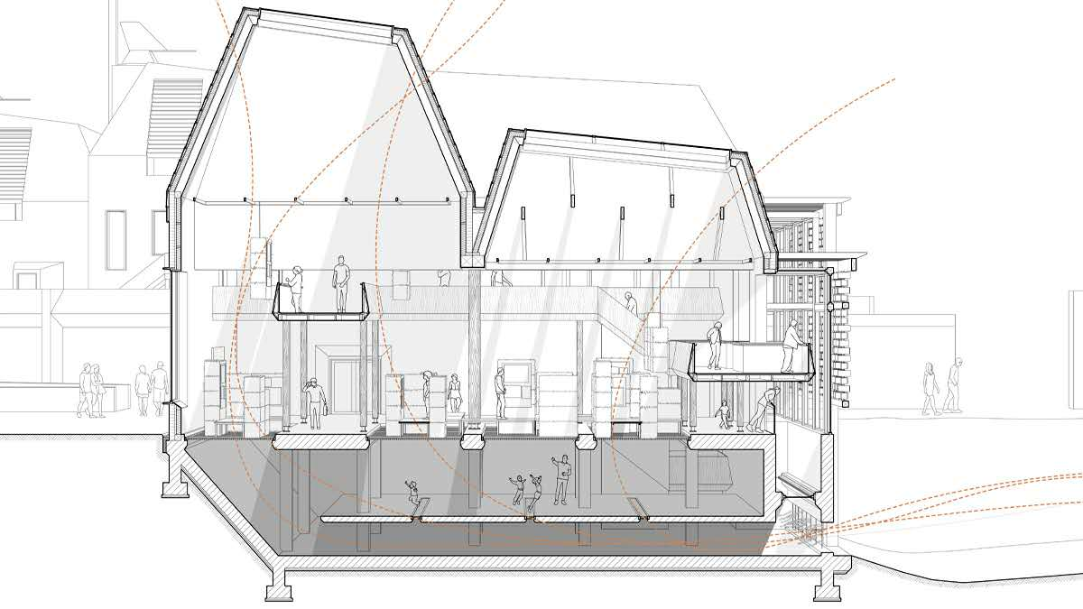
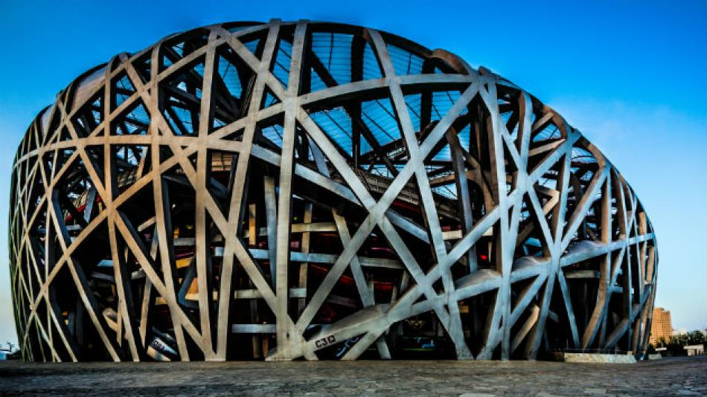
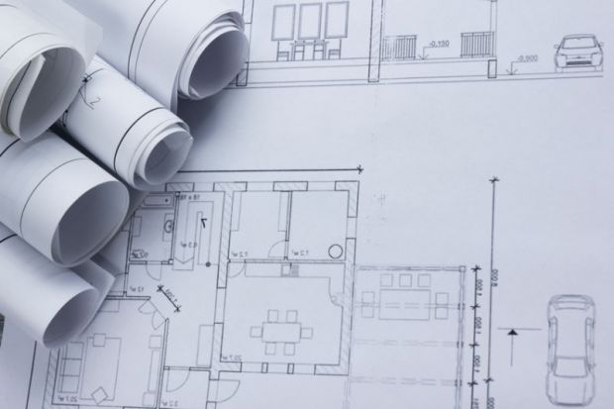
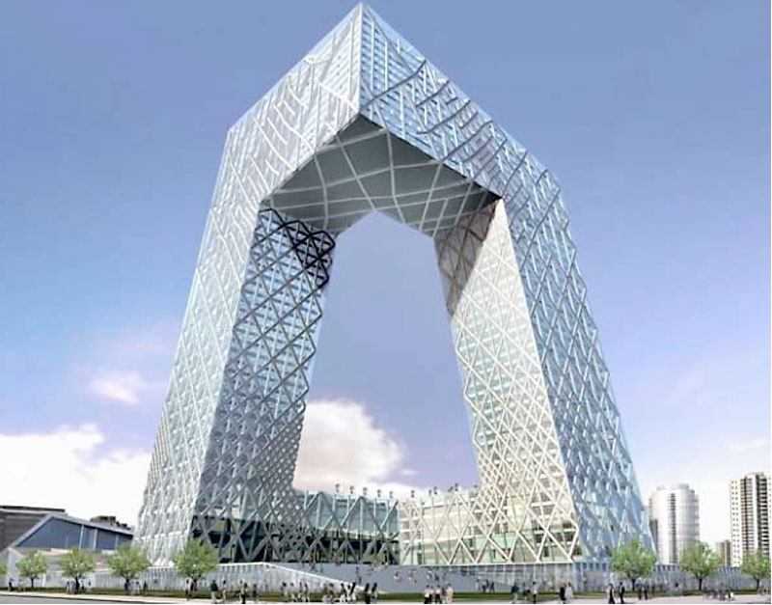
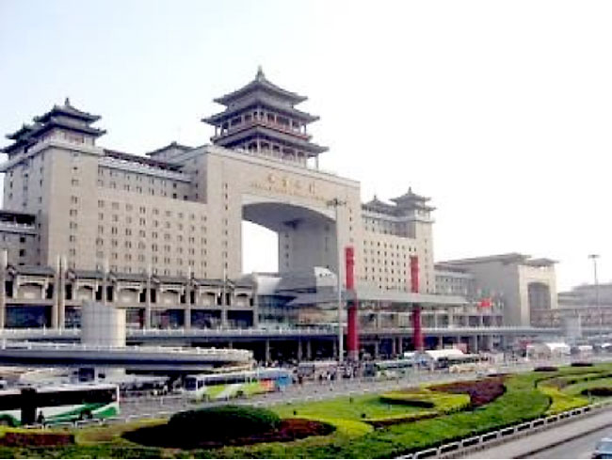
Architecture

Slide 150
Architecture
建筑 -建筑学
In English, the same word "Architecture" is used as a metaphor for many modern techniques or fields for structuring abstractions.
For example, systems architecture - 系统架构
In Chinese, these two meanings are reflected by different words

Slide 151
Architecture - 架构
The process of planning, designing and constructing structures

Slide 152

Architecture
The process of planning, designing and constructing structures
Building

Slide 153
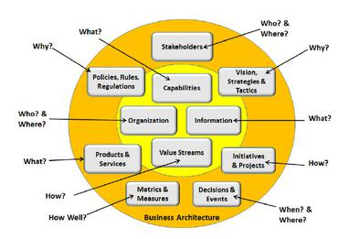
Architecture
The process of planning, designing and constructing structures
Building
Business

Slide 154
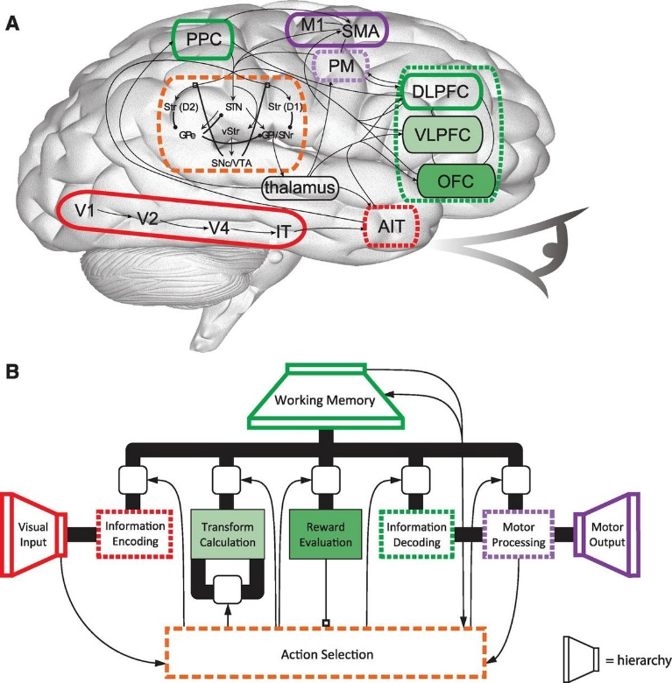
Architecture
The process of planning, designing and constructing structures
Building
Business
Cognitive

Slide 155
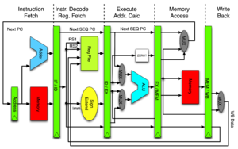
Architecture
The process of planning, designing and constructing structures
Building
Business
Cognitive
Computer 计算机系统结构

Slide 156
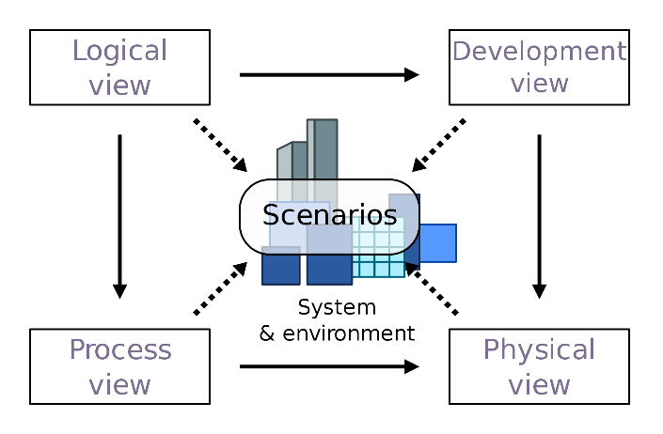
Architecture
The process of planning, designing and constructing structures
Building
Business
Cognitive
Computer
Software 软件架构
…..

Slide 157
What is Architecture?
The architecture of a system is the set of structures needed to reason about the system, which comprise elements, relations among them, and properties of both.

Slide 158
What is Architecture?
The architecture of a system is the set of structures needed to reason about the system, which comprise elements, relations among them, and properties of both.

Slide 159
Reference Architecture
A reference architecture provides a template solution for an architecture for a particular domain
It also provides a common vocabulary with which to discuss implementations, often with the aim to stress commonality
It refers to any system in this domain
Not to a specific implementation of the system

Slide 160
Cloud Computing Reference Architecture
Defines the basic building blocks—architectural elements and their relationships—which make up the cloud
Cloud computing roles
Cloud computing activities
Cloud computing functional components and their relationships

Slide 161
Standards describing CCRA
Before 2010, cloud computing reference models were proposed by multiple cloud organizations, vendors, and federal agencies
Example: 2010 – CCRA developed by IBM
In 2011 CCRA developed by NIST was published
The team from NIST surveyed and completed an initial analysis of existing cloud computing reference models and developed a neutral model of architectural concepts
In 2014 ISO together with IEC published an international standard describing CCRA

Slide 162
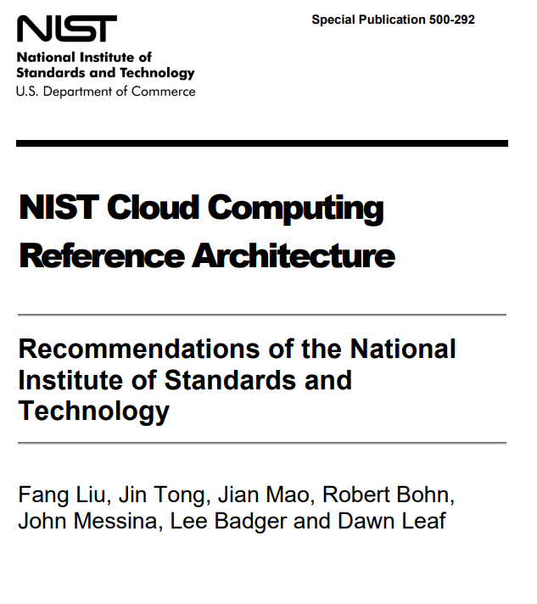
CRRA developed by NIST
NIST - National Institute of Standards and Technology
SP 800-145: The NIST Definition of Cloud Computing
SP 800-146: Cloud Computing Synopsis and Recommendations
SP 500-292: NIST Cloud Computing Reference Architecture

Slide 164
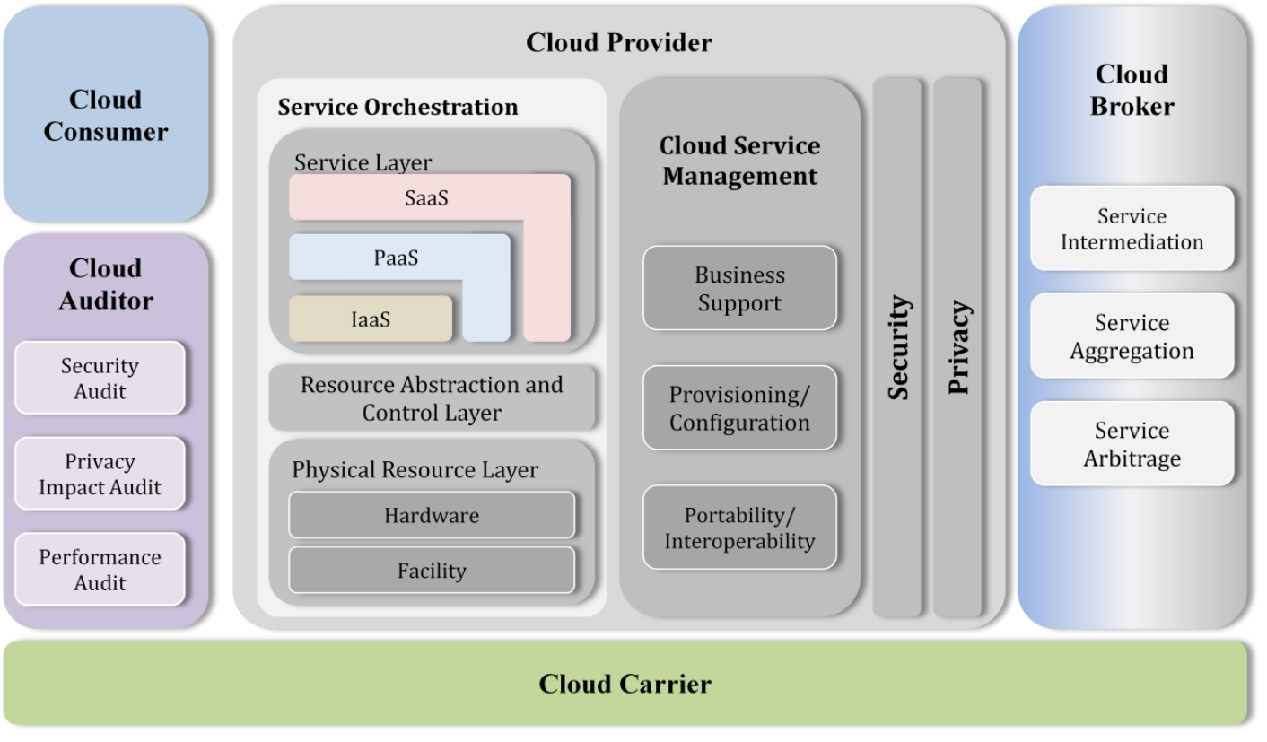
Overview of NIST CCRA

Slide 165
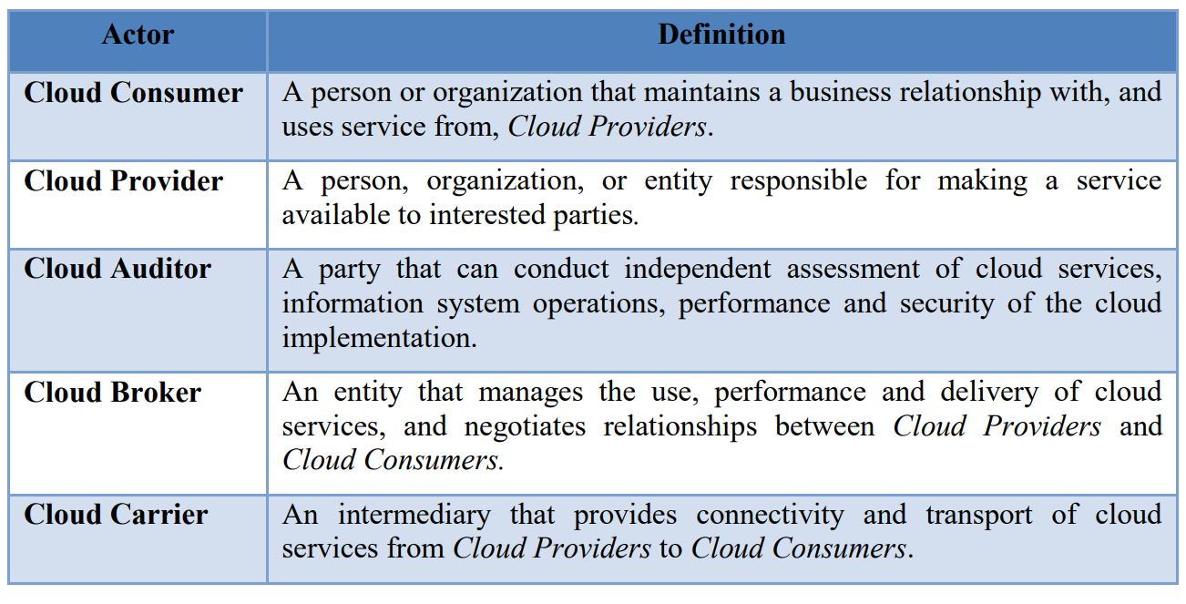
Cloud computing actors

Slide 166
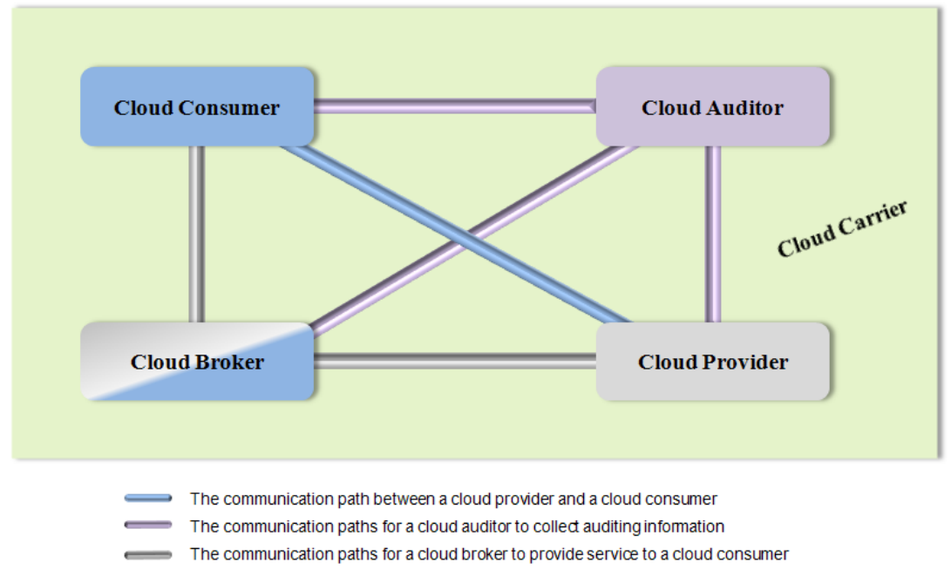
Interactions between the actors

